Slide 1
Electronic Dictionary Instructions
Open MS PowerPoint
Save your presentation to your 0365 Account in your class folder as:
  Ch. ? Electronic Dictionary
Create your Electronic Dictionary
  Next, create a Title Slide that states
    Electronic Dictionary, Class Name & Your Name
  Create a List of Words Slide
  Create a slide for each vocabulary word
    Define each word
    Use each word in a sentence
    Add an image that fits the vocabulary word.
  Create a Resources Slide
When done save all of your changes.
Send the completed document in an email message to tellsworth@fillmorecsd.org as an attachment.
  Subject line: IB - Ch. 1 Electronic Dictionary

Slide 2
Ch. 1 Electronic Dictionary
Marketing
Your Name

Slide 3
List of Ch. 1 Words
Bricks & mortar
Dot.com
E-commerce
Economic utility
Exchange
Law of demand
Law of supply
Marketing
Marketing concept

Slide 4
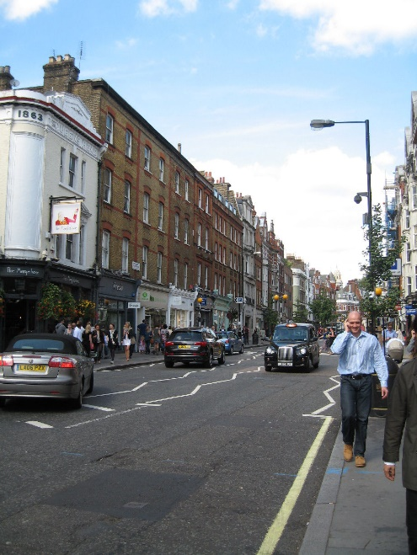
Bricks and mortar
Definition – A business that completes most of its business activities in traditional ways.
Use in a sentence – I run an bricks and mortar business down town on Main Street.

Slide 5
Dot.com
Definition –
Use in a sentence –
Add an image -

Slide 6
E-commerce
Definition –
Use in a sentence –
Add an image -

Slide 7
Economic utility
Definition –
Use in a sentence –
Add an image -

Slide 8
exchange
Definition –
Use in a sentence –
Add an image -

Slide 9
Law of demand
Definition –
Use in a sentence –
Add an image -

Slide 10
Law of supply
Definition –
Use in a sentence –
Add an image -

Slide 11
marketing
Definition –
Use in a sentence –
Add an image -

Slide 12
Marketing concept
Definition –
Use in a sentence –
Add an image -

Slide 13
Resources
Introduction to Marketing
MS Power Point Online Images
Google Images

